Slide 1
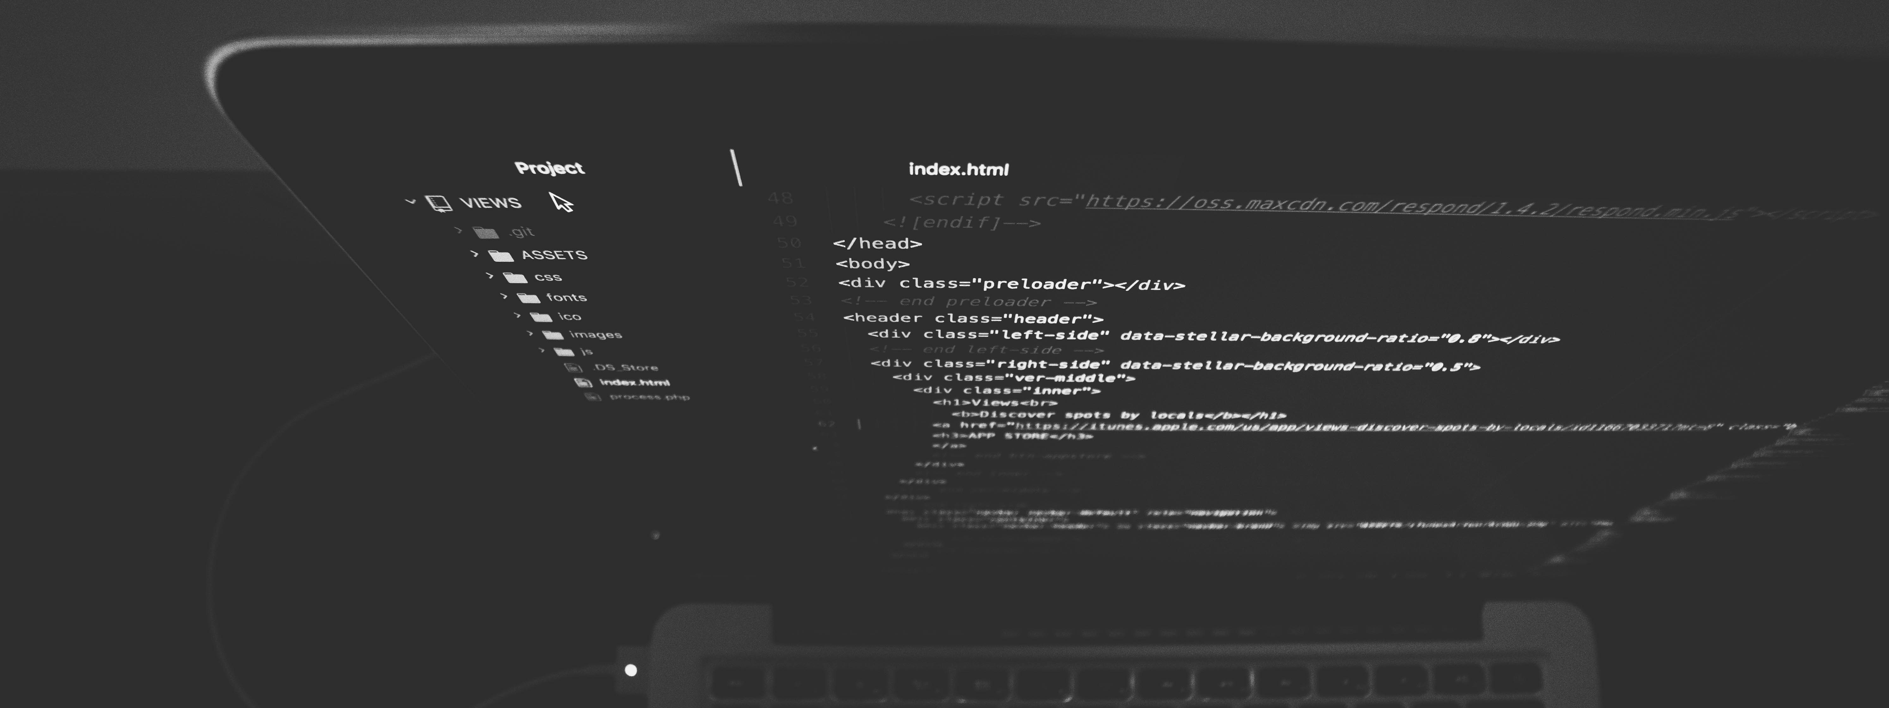
SOCIAL APP USING REACT NATIVE
MIR HUMAYUN NISAR AWAIS ADNAN ASAD MANZOOR

Slide 2
React Native
One of the most popular and widely used cross-platform mobile application development framework
A very large community of programmers working constantly towards its improvement
Covers two major eco-systems: Android and iOS
Purely focused on UI design- greatly responsive and has the best rendering abilities.

Slide 3
Firebase
Backend as a Service, that works as your API, server and your datastore
Providing a real-time database connected through WebSocket
A fully-featured App platform in essence
Provides a simple way to save binary files

Slide 4
React Native Modules
Following is the list of modules we used:
react-navigation (for navigation)
react-navigation-stack (for navigation)
react-navigation-tabs (for navigation)
React-native-ionicons (to use different icons like camera, heart etc)
React-native-image-picker (to pick image from the gallery of mobile)

Slide 5
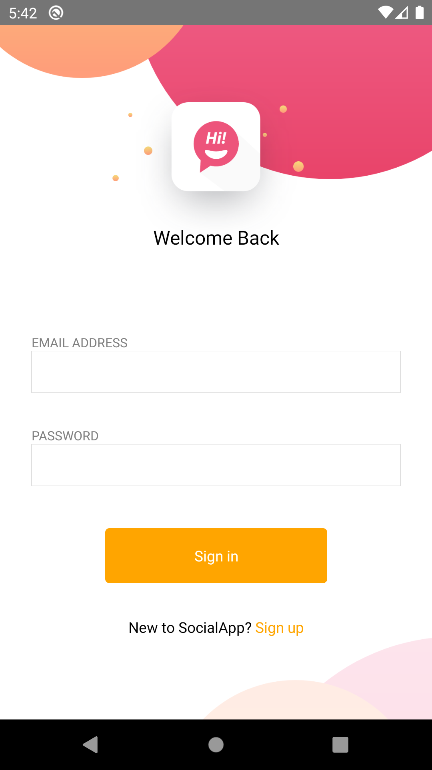
Login Screen
It includes the basic components of react-native for its user interface
View
Text
TextInput
TouchableOpacity
StyleSheet
Data entered is validated through firebase database and if user exists he is logged in.

Slide 6
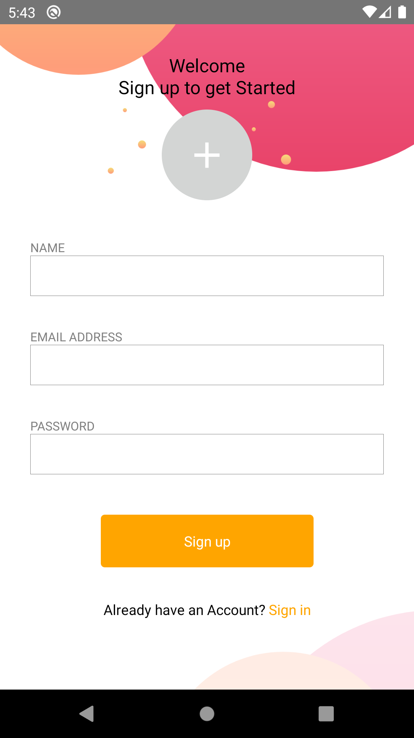
Register Screen
Similar to Login Page in user interface using similar components.
Only a single User can be signed up using a single email
After validating email format and other validation , the data is stored in the firebase and the user is logged in.

Slide 7
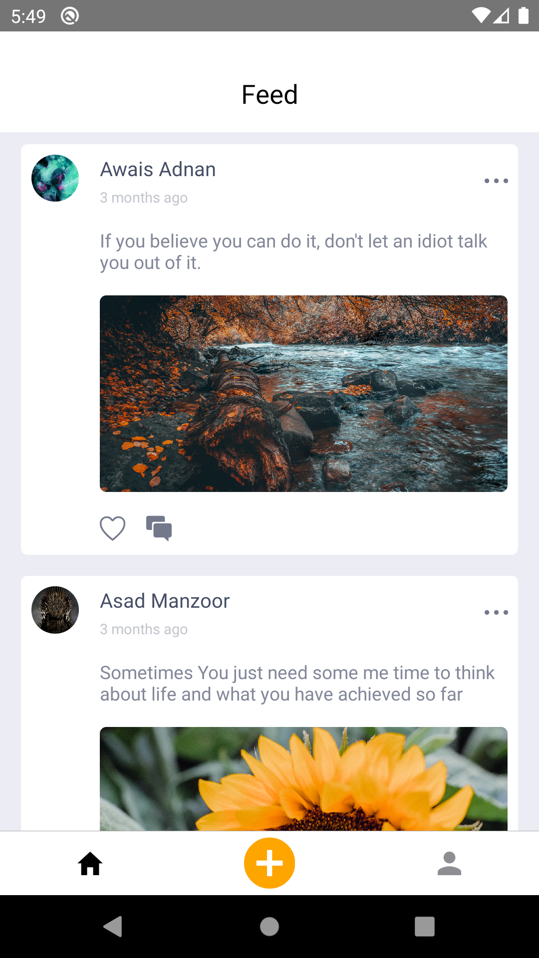
Home Screen
It contains all the posts from different people using this app.
User interface is made using the basic components like in the first two screens
{FlatList} is a new component used in it to maintain the feed.
Data is taken from the firebase.

Slide 8
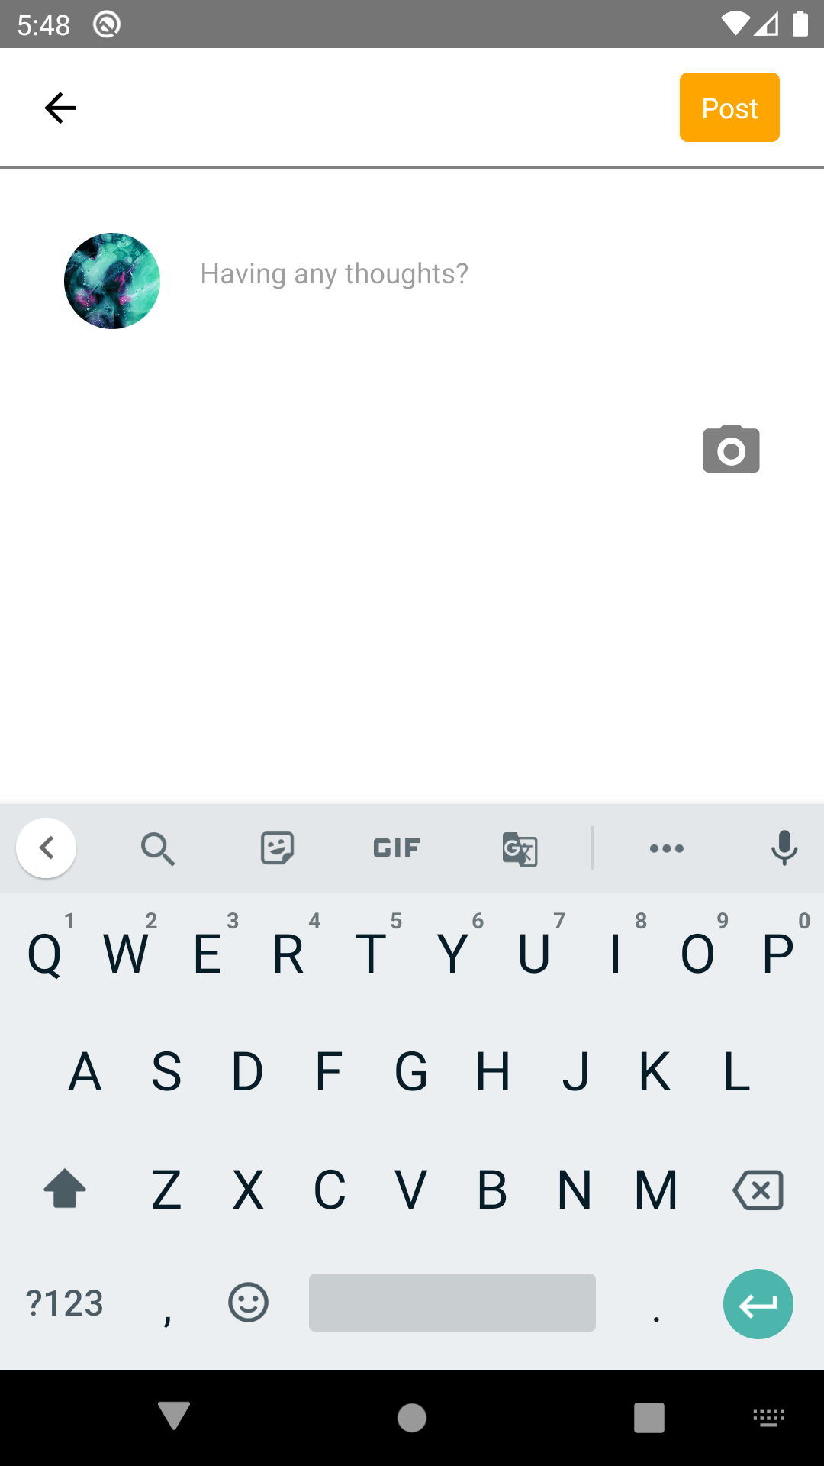
Post Screen
This is the screen where user uploads a photo and status.
The status and photo is stored in the firebase.

Slide 9
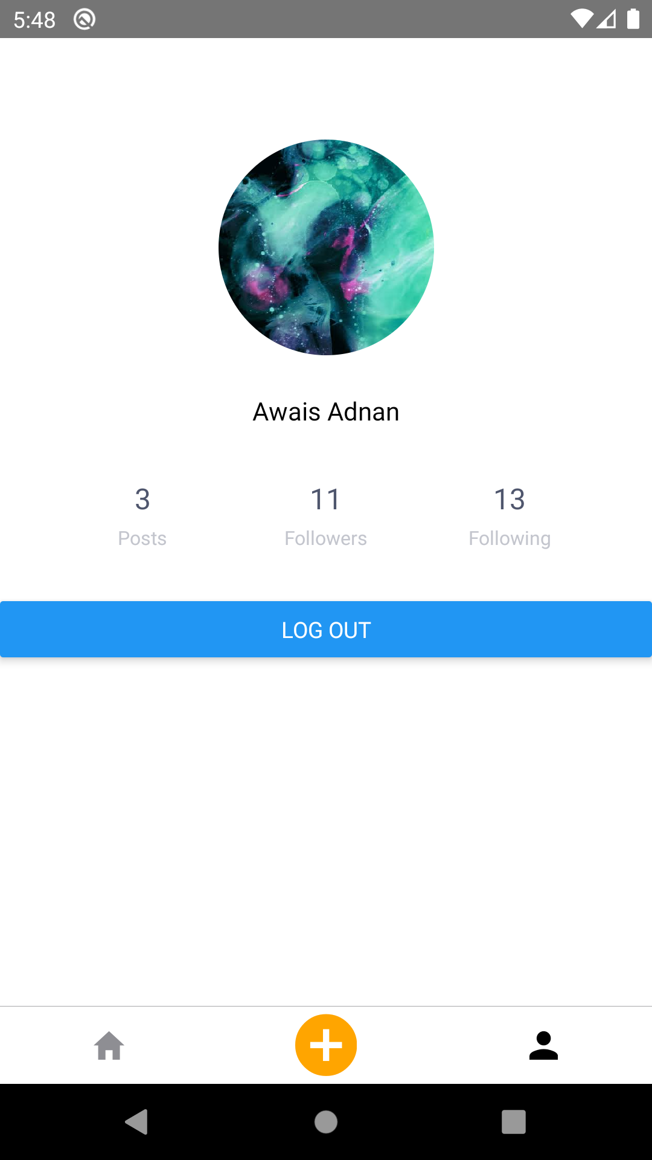
Profile Screen
The screen which contains user’s name and other information like number of posts , followers etc
It also contains the logout button which logs the user out of the app.

